Slide 1

Introduction to Word Processing

Slide 2
Directions page
Click to Exit the package
Click to go to the lesson Menu
Click to go to the Last Slide Viewed
Click when you need Help
Click to go to the Next Slide
Click to go to the Previous Slide
Previous
Back

Slide 3
Menu page
Previous
Back

Slide 4
objectives
By the end of the lesson, students should be able to;
open up Microsoft word
Create documents in Microsoft word
Cut, copy and paste in Microsoft word
Find a Microsoft word document
Print Microsoft word documents
Previous
Back

Slide 5
Practice exercise
If you click on the Previous button,
Click on the correct answer.
Previous
Back

Slide 6
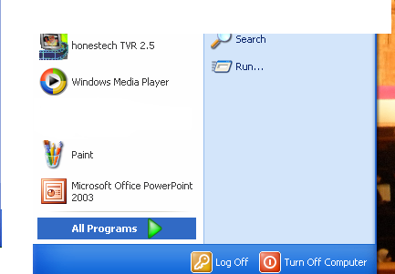
Starting Microsoft word
Click on the
start button
Previous
Back

Slide 7
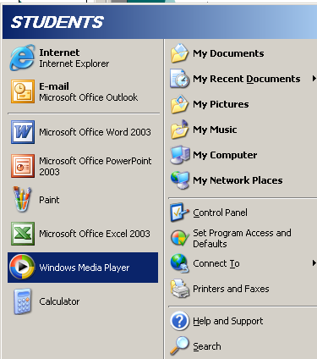
Click on All
Programmes
Previous
Back

Slide 8
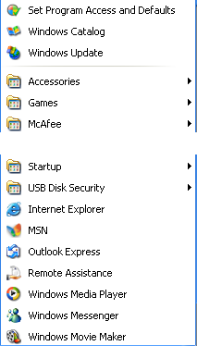
Click here
Previous
Back

Slide 9
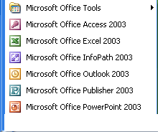
Then click on
Microsoft
Office Word
2003
Previous
Back

Slide 10
Assessment question
Click start, click all programs, then click on Microsoft office and then select Microsoft word when opening Microsoft word, say if True or False?
(type in the correct answer the way it appears following its characterization).
Previous
Back

Slide 11
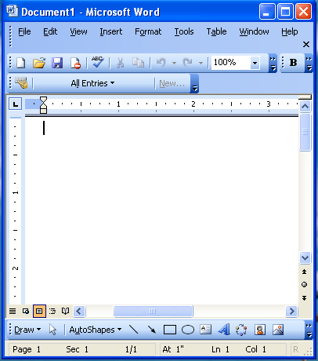
Creating a document in Ms word
Following the different methods and steps given while opening up Microsoft word in slide 6-9, a Microsoft word document is created. However, there are also other ways of creating a document in Ms Word,
Click on Next.
Previous
Back

Slide 12
Creating a document…
New Blank Document - Creates a new document with a single page. When a document is open the name of the document is displayed in the title bar (top left corner).
By default every new document consists of a single page.
Previous
Back

Slide 13
Creating a file from an existing document
It is also possible to create a new document which is based on an existing document.
Select (File > New) and to display the New Document task pane and click on the "From existing document" hyperlink.
This displays the "new from Existing Document" dialog box which can be used to select the document you want to use. Click on Next for illustration.
Previous
Back

Slide 14
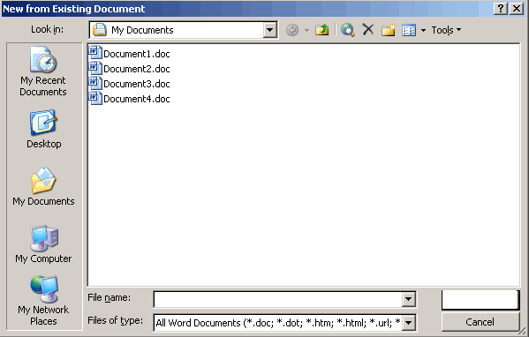
illustration
Once you have selected an existing document all the pages from this document will be used to create a new document.
Click here
Previous
Back

Slide 15
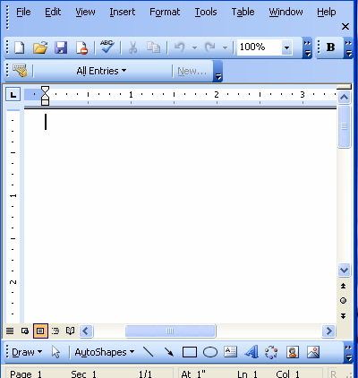
Creating…
A file from an existing document has been created. Click Next.
Previous
Back

Slide 16
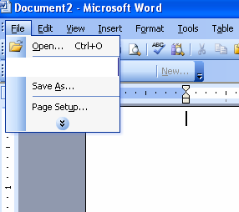
Saving a document in Ms word
Click here for details
With saving documents, on the main menu, choose File > Save.
Click Save Ctrl+S after details for saving documents.
Click on save
Ctrl+S
Previous
Back

Slide 17
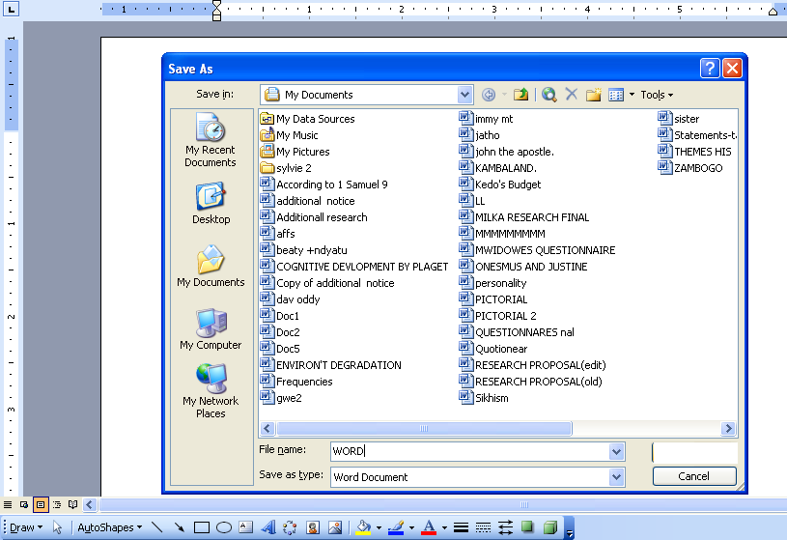
Saving…
type your file name in the "File Name" box and then click save.
Click save
Previous
Back

Slide 18
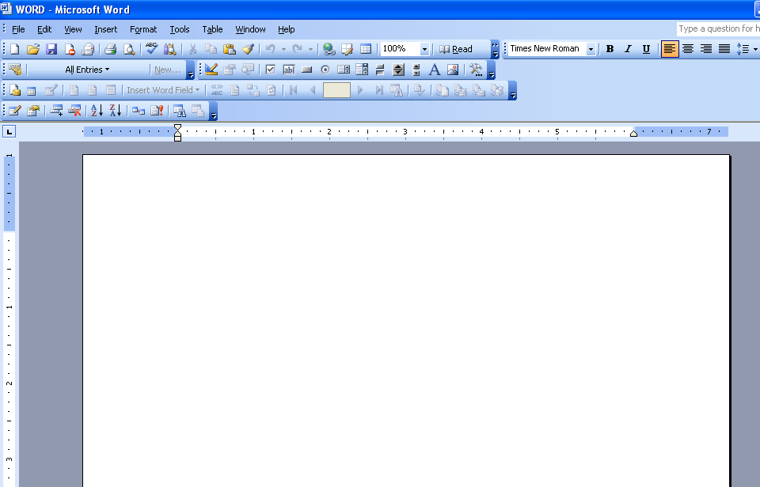
Saving…
This will take you to the Microsoft word environment of the document saved.
Click on Next to continue.
Previous
Back

Slide 19
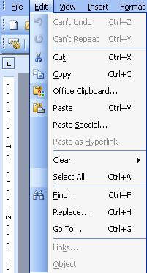
Editing a document in Ms word
Using this option (editing) you can perform editing functions such as cut, copy, paste, Find and many others as shown
Click here to continue
Previous
Back

Slide 20
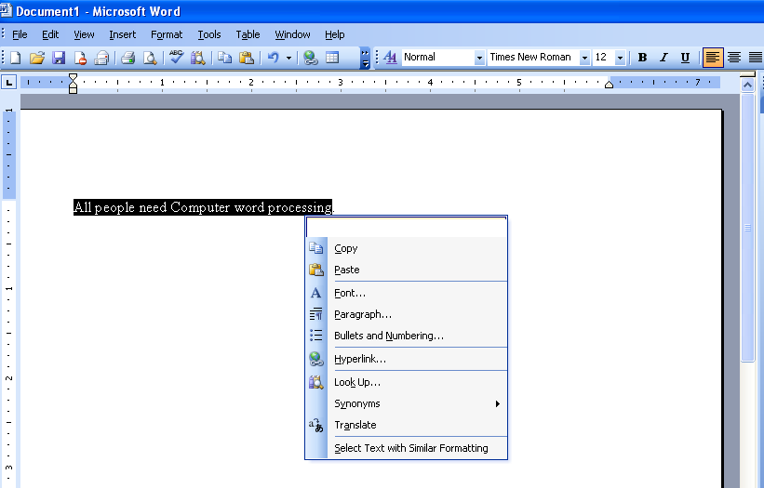
Cutting
Highlight the text needed and then right click
Click here
Previous
Back

Slide 21
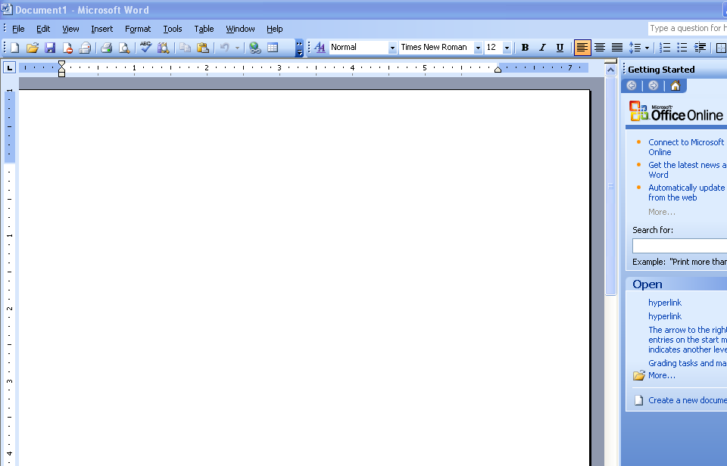
Cutting…
Text disappears from view.
Then position the cursor where you want the text to appear.
Click on Edit and go to
Paste or click on
the paste button.
Click here
Previous
Back

Slide 22
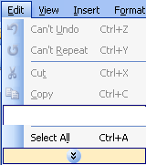
pasting
OR
Or you may also click here
Click here
Previous
Back

Slide 23
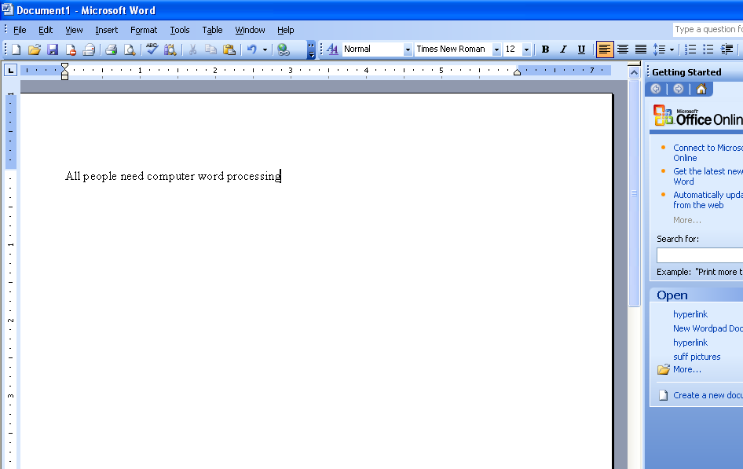
pasting …
What you cut has now been pasted.
Click on Next to continue
Previous
Back

Slide 24
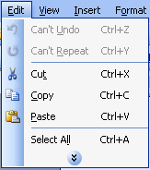
Copying a document in Ms word
Follow the steps for the cutting option but put in mind that copy should be the option used
N.B.
This option (copy) can be used to copy files from different locations like from the desktop to a flash disk or to my documents or to another file
Click here to continue
Previous
Back

Slide 25
Formatting a document in Ms word
This simply means change of appearance of text i.e. character formatting, font and font size or even style among others. All the above are found on the formatting tool bar as illustrated below;
Click here for the formatting tool bar illustrations
Click Next after the formatting tool bar illustrations
Previous
Back

Slide 26
Adding boarders
Adding Borders
There are a few ways you can add borders to text but the easiest is to use one of the following two buttons.
There is a borders button on the Formatting toolbar.
Borders - Formatting toolbar
There is also a borders button on the Tables and Borders toolbar.
Click Next to continue
Previous
Back

Slide 27
Boarders…
Borders - Tables and Borders toolbar
Both these buttons will toggle borders on or off.
The border you last choose will stay displayed for the current session.
The default border that is displayed when you first open Word is the outside border.
Adjusting one of these buttons will not adjust the other.
Click Next to continue.
Previous
Back

Slide 28
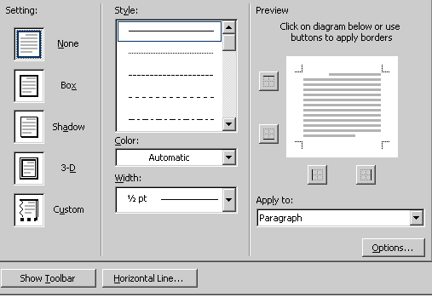
Adding Borders and shadings to Text
Highlight the text and use the Border buttons from one of the toolbars.
When you press this button the selected border option will be applied.
You can use the border buttons arrow to select a different type of border. When you want to apply a different type of border to the default border you can use the Borders and Shading dialog box.
Select (Format > Borders & Shading) Borders tab).
Click Next to continue.
Previous
Back

Slide 29
Indentation
What is an Indent ?
An indent is the amount of space used to offset a paragraph from the margin. Never use multiple spaces to position text.
Space text horizontally by using tabs, indents and other paragraph alignment techniques (Format > Paragraph).
Spaces are subject to change (especially multiple spaces) as they are dependent on font and size)
Left and right indents are often used together to indent blocks of text such as quotes.
Click here to continue
Previous
Back

Slide 30
Paragraph Dialog Box
This dialog box can be used to create and adjust the exact location of your indents.
Left - Indents a paragraph from the left margin by the amount you enter in this box. If you want text to appear in the left margin, enter a negative number.
Right - Indents a paragraph from the right margin by the amount you enter in this box. If you want text to appear in the right margin, enter a negative number.
Special - Click First line to indent only the first line of a paragraph. Click Hanging to indent all but the first line of a paragraph. Click (none) to remove special indentation formatting.
Click here to continue
Previous
Back

Slide 31
How to indent
One of the quickest ways to indent is to use the Increase and Decrease indent on the formatting toolbar.
Increase Indent - Increases the indent.
Decrease Indent - Decreases or removes the indent.
These button will increase or decrease the position of the indent by one tab stop. Click here to continue
Previous
Back

Slide 32
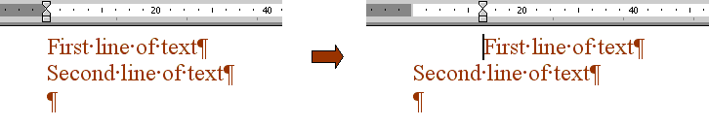
Left Indent
Left Indent - Positions the left edge of the text
Before left indention
After left indention
Previous
Back

Slide 33
Left indent…
The ruler displays three triangular sliders. The left and right indent sliders are on the bottom and the first line indent slider is on the top. The box at the bottom moves both the left indent and the first line indent.
The rectangle underneath the ruler can be used to move both the top and bottom triangles at the same time.
Adjustments made to the margins affect the current insertion point and any text entered there after.
Click here to continue
Previous
Back

Slide 34
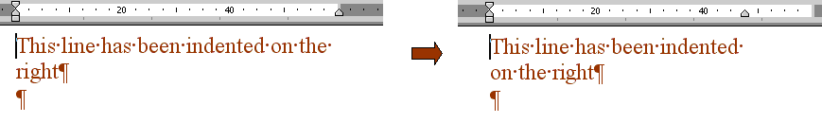
Right indent
Right Indent - Positions the right edge of the text
Before left indention
After left indention
Previous
Back

Slide 35
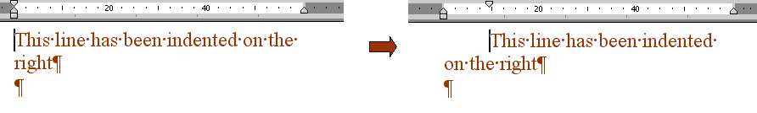
First Line Indent
First Line Indent - Position of the left edge of the first line of the paragraph
Before left indention
After left indention
Previous
Back

Slide 36
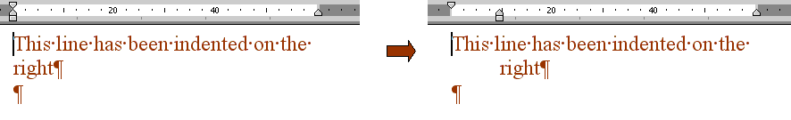
Hanging Indent
Hanging indents allow the user to create number paragraphs and bullets points.
Hanging indents are often used in numbered and bulleted lists.
Before left indention
After left indention
Previous
Back

Slide 37
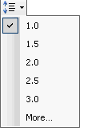
Line spacing
(Format > Paragraph).
This changes the line spacing between the lines in a paragraph and this is often referred to as "Leading".
Use the button on the Formatting toolbar to view and therefore use this for your preferred line spacing.
Previous
Back

Slide 38
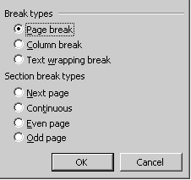
Page breaks
Manual Page Breaks
When you fill a page with text or graphics, Microsoft Word inserts an automatic page break and starts a new page.
To force a page break at a specific location, you can insert a manual page break.
(Insert > Break).
For example, you can force a page break to ensure that a chapter title always starts on a new page.
Previous
Back

Slide 39
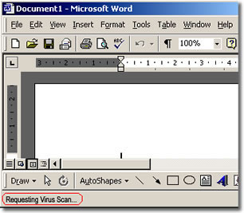
Printing a document in Ms word
You can print the
active document by
clicking Print on the
Standard tool bar the icon shown
Previous
Back

Slide 40
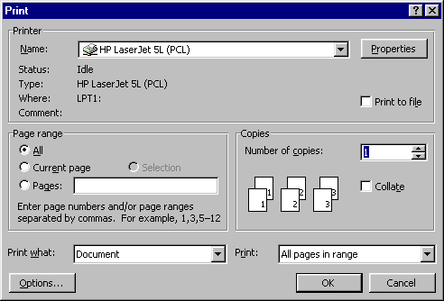
printing…
This will bring you the print preview dialogue box
This is what is called the Print Preview.
Click here for details
Previous
Back

Slide 41

Print preview
In short, the Print Preview feature allows you to see how a document will look when you print it. It also allows you to do last minute formatting on the document.
Previous
Back

Slide 42
Practice exercise
You can use Microsoft word to;
Previous
Back

Slide 43
Glossary
Active document : the document being worked on at that particular time.
Cancel - Closes the dialog box
Standard tool bar: a row of buttons used to execute commands with a mouse like save, open, print e.t.c.
Hanging Indent - Leave the first line alone but position the every other line of the paragraph
Scroll bars: a vertical bar on the right side of a window or a horizontal bar at the bottom of a window that is used to move the window contents up and down or left and right.
Text wrap: a term used in page layout specifically to the way text can be shaped around the edges of images.
Save in - Displays the current folder where the workbook will be saved. To change to a different folder or disk drive, open the Save in drop-down list and select the name of the folder or letter of the disk drive.
File name - The name of the file you want to use to save this document.
Save as type - Provides a list of all the different formats you can save a Word document as.
Save - Saves a permanent copy of the document in the selected folder, using the filename you typed or Saves the active document.
What is Line Spacing ?
Line spacing refers to the space between the bottom of one line and the bottom of the next line and can be changed from
Previous
Back

Slide 44
sources
A Computer Work Book.
http:encyclopedia2.thefreedictionary.com/scroll+bar
www.youthdesigner.com/2997/09/22/design_terms
Click Exit to end presentation or Next to resume the presentation.
Previous
Back

